Slide 1

Healthy People 2030
Goal: Improve health by promoting healthy eating and making nutritious foods available.

Slide 2
Overview
Many people in the United States don’t eat a healthy diet. To reduce the risk for chronic diseases and improve overall health, it is recommended to eat healthier foods like whole fruit.
The goal of this presentation is to provide regional analysis of obesity and consumption behaviors along with optimal fruit tree planting zones. By combining this data we can gain insight as to which areas and demographics would benefit most from localized fruit growth.

Slide 3
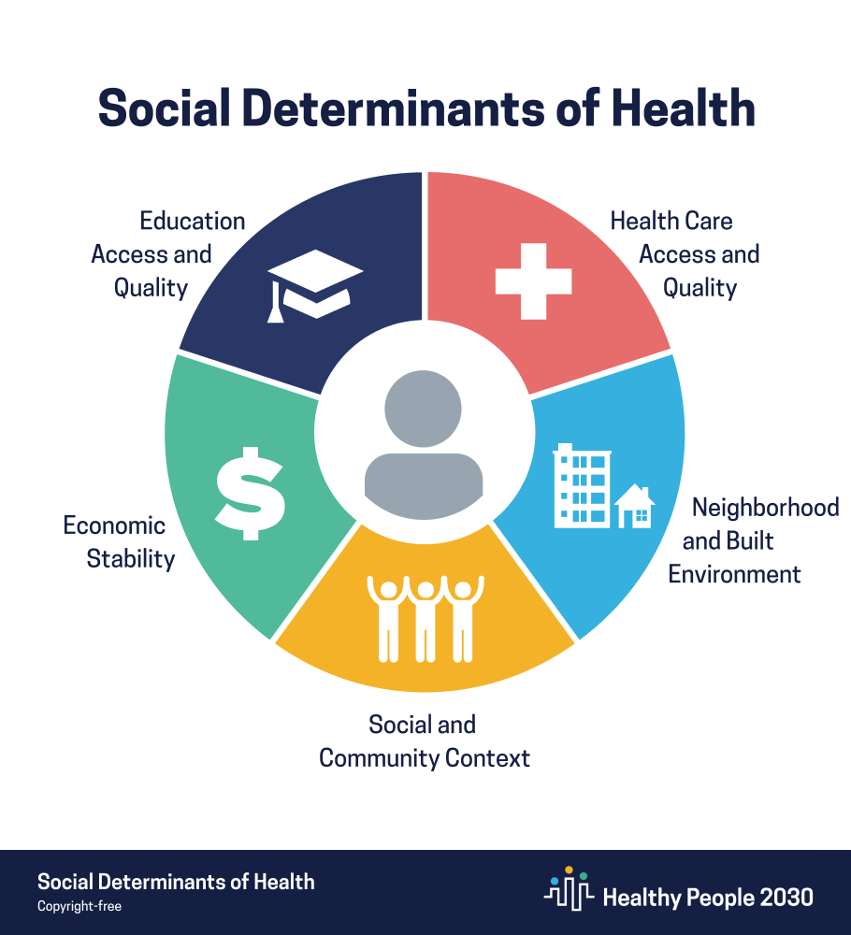
SDOH Item Topics Covered: - Education, job opportunities, and income. - Access to nutritious foods and physical activity opportunities.
Social determinants of health (SDOH) have a major impact on people’s health, well-being, and quality of life.

Slide 4


Key Issues
Education:
- Groups with higher education tend to have healthier diets and more whole fruit consumption rates.
- Groups with higher education see less obesity among adults than the less educated.
- Which regions would be most positively impacted by educational initiatives?
Access:
- People with low income and low accessibility tend to consume less whole fruit, which can lead to chronic illness.
- Localizing and maximizing food growth in these areas can benefit local economy, food supply, and consumption behavior.
- Which regions would be most positively impacted by local fruit growth initiatives?

Slide 5
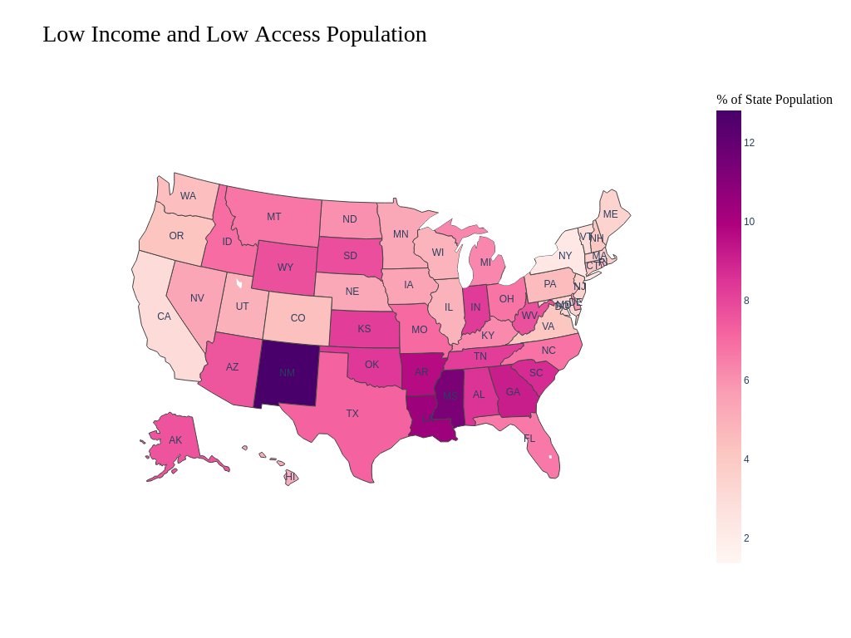

Low Access defined as:
Urban populations living 1 or more miles from a food store.
Rural populations living 10 or more miles from a food store.
Low Income defined as:
The tract’s poverty rate is 20 percent or greater; or
The tract’s median family income is less than or equal to 80 percent of the State-wide median family income; or
The tract is in a metropolitan area and has a median family income less than or equal to 80 percent of the metropolitan area's median family income.

Slide 6
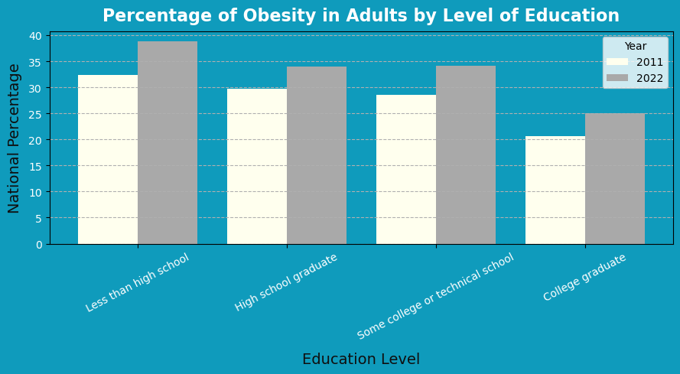
National Health
Influence of Education
As obesity rates steadily rise, there is a consistent higher percentage of obesity among less educated populations. Health programs should engage with this demographic of the population to provide nutritional information and access to healthy foods.

Slide 7
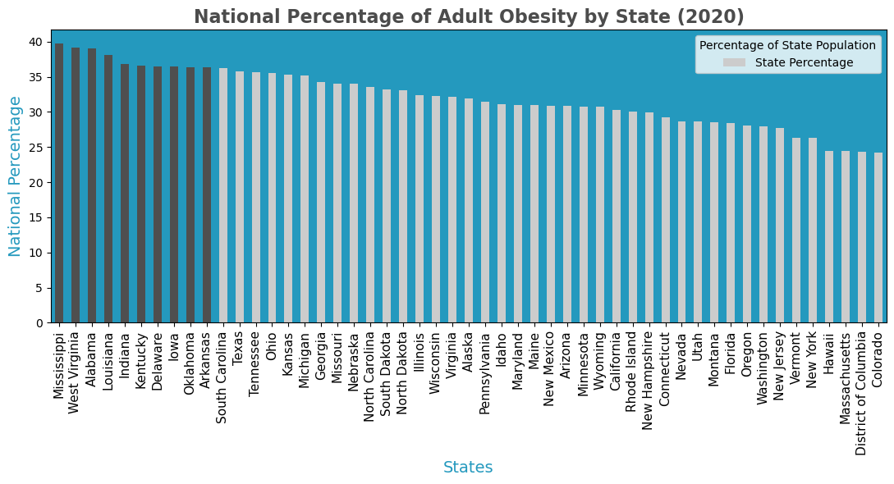
State Health
10 States with Highest % Obesity
Mississippi
West Virginia
Alabama
Louisiana
Indiana
Kentucky
Delaware
Iowa
Oklahoma
Arkansas

Slide 8
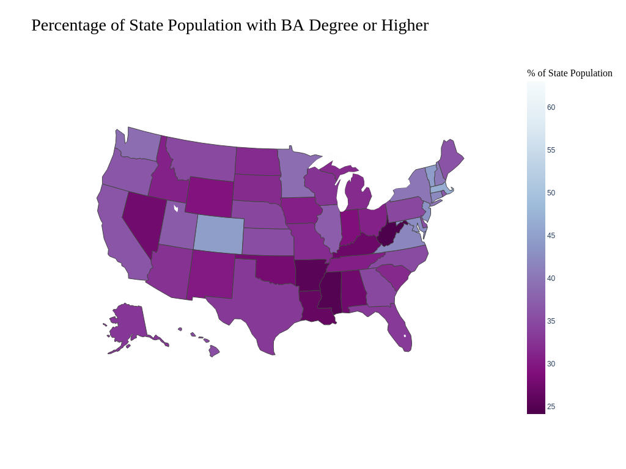
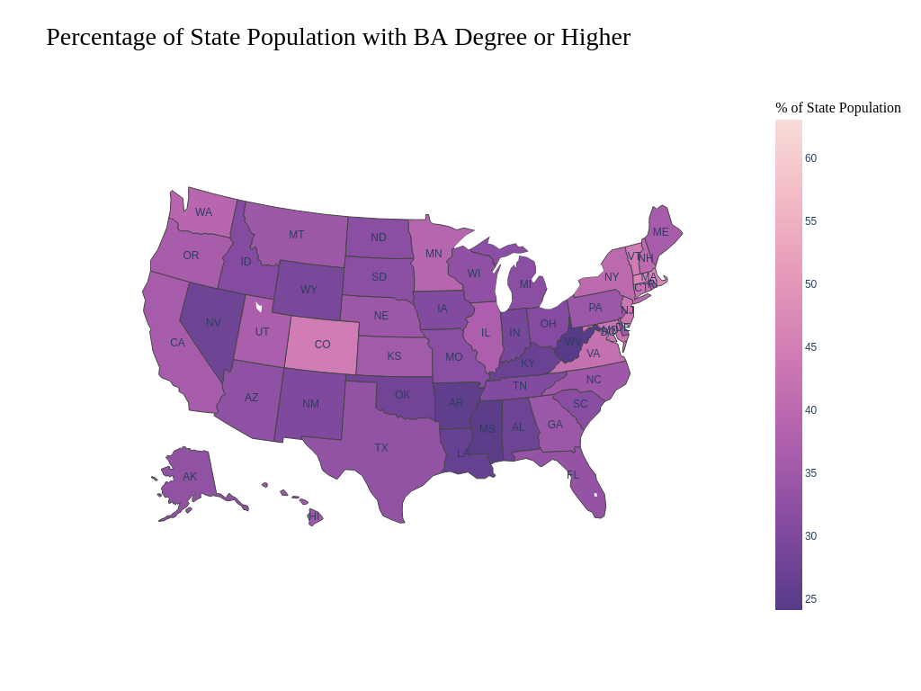
10 States with Highest % Obesity
Mississippi
West Virginia
Alabama
Louisiana
Indiana
Kentucky
Delaware
Iowa
Oklahoma
Arkansas

Slide 9
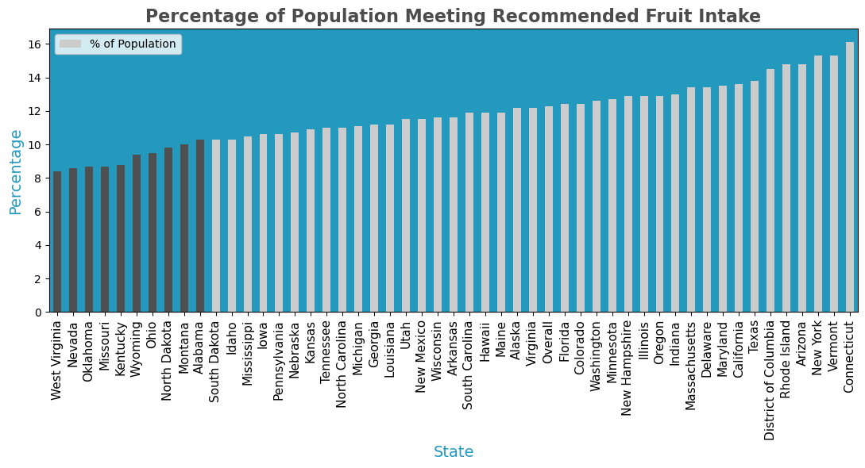
State Health
10 States with Lowest % Meeting Recommended Intake
West Virginia
Nevada
Oklahoma
Missouri
Kentucky
Wyoming
Ohio
North Dakota
Montana
Alabama

Slide 10
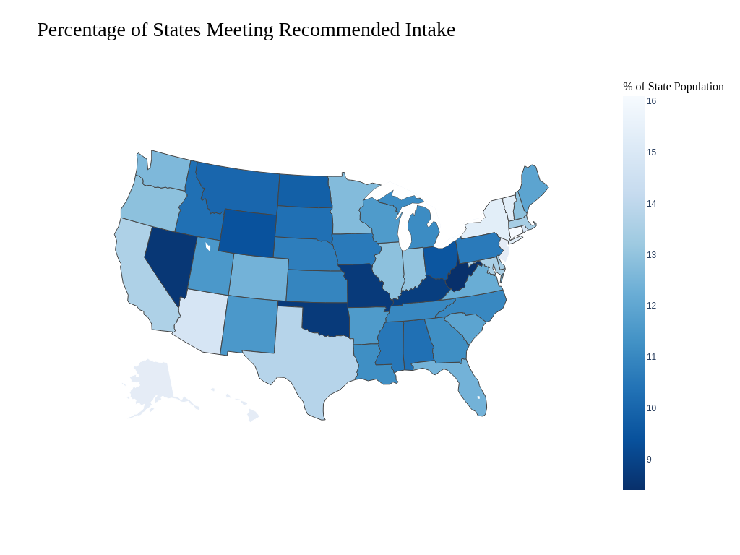

* The United States Department of Health and Human Services (HHS) recommends that adults consume:
at least two cups of fruit per day as part of a healthy and balanced diet.

Slide 11
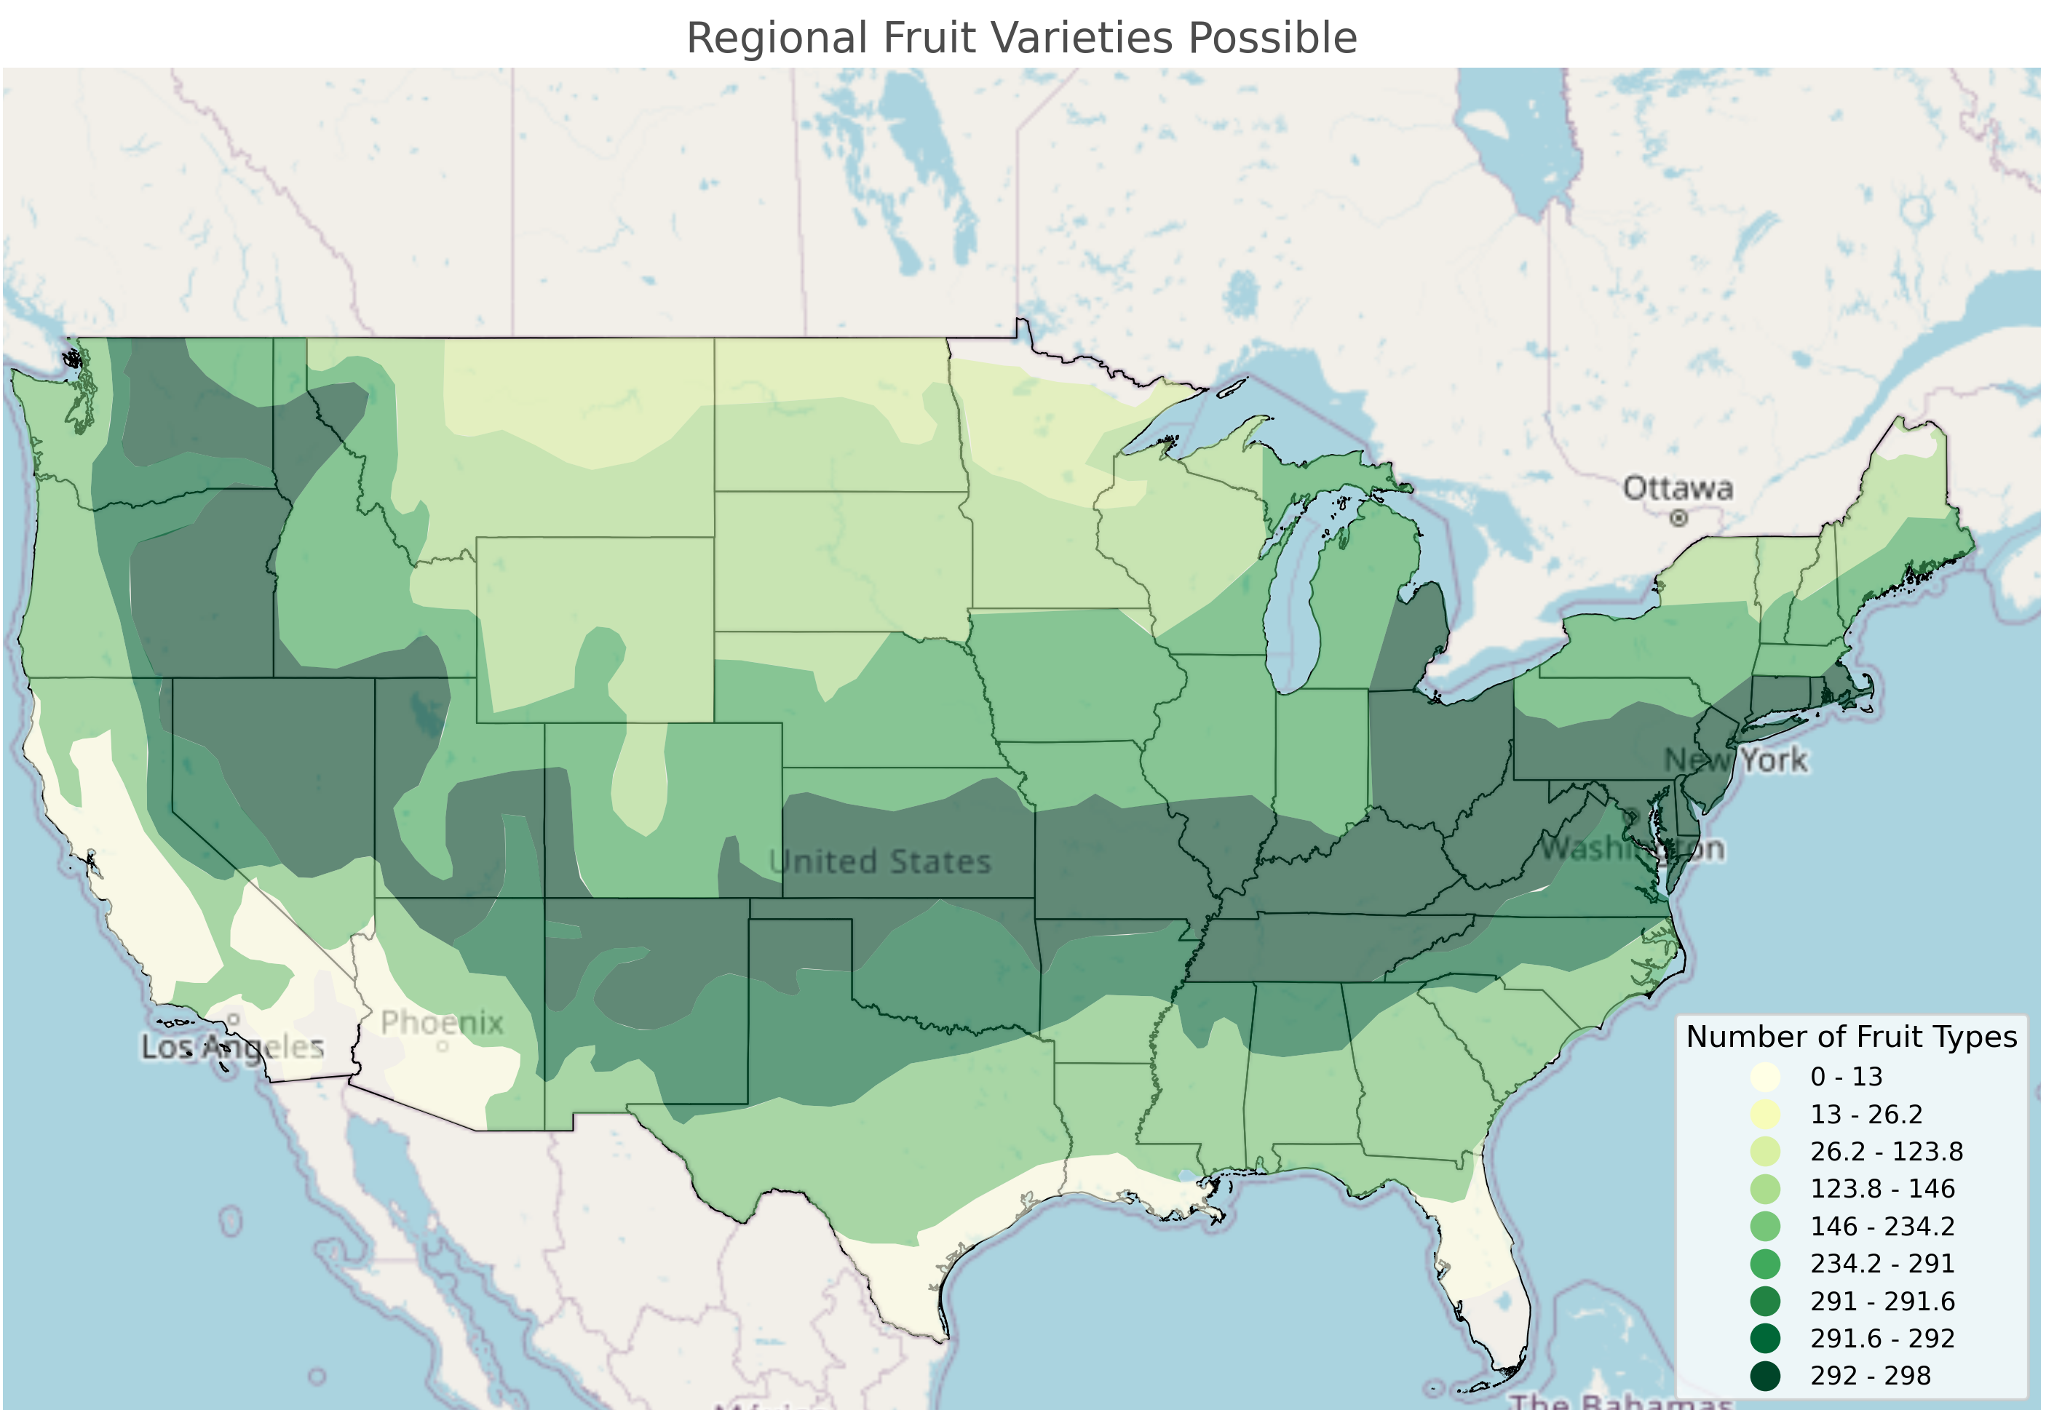
*Numbers represent unique variety total in all categories.
Categories included are:
- Apple
- Peach
- Pear
- Plum
- Cherry
- Nectarine
- Apricot
Click to view interactive map.

Slide 12

Thank you

